Slide 1




CYSE7200-Final Project Presentation
Age Assessment and Disease Risk Prediction
Team Members:
Adwaith Korapati
Tirth Patel
Shreemoy Nanda
CYSE7200 Big-Data Sys Engr Using Scala

Slide 2
Use Cases
A healthcare professional needs to assess a patient's risk of developing a specific disease. They input relevant information into a custom UI.
The UI passes this information to a machine learning model, which predicts the patient's age and the probability of them developing the specified disease.
The model provides the age prediction and disease risk probability back to the healthcare worker.
CYSE7200 Big-Data Sys Engr Using Scala

Slide 3
Methodology
Acquire data, either by downloading it or through an API connection, which amounts to approximately 15GB of data.
Perform data profiling, data cleansing, and exploratory data analysis (EDA).
Train machine learning models for age prediction and perform unit testing using the cleaned dataset.
Train machine learning models for disease risk prediction and conduct unit testing.
Build a user interface using Scala JS and perform unit testing.
Integrate the system, conduct unit testing, and prepare for the final presentation.
CYSE7200 Big-Data Sys Engr Using Scala

Slide 4
Data Source
Data source contains Approx. 15GB of data.
Kaggle (//www.kaggle.com/datasets/marquis03/age-assessment-and-disease-risk-prediction/data)
CYSE7200 Big-Data Sys Engr Using Scala

Slide 5
Milestones/Sprints
2 Nov -9 Nov: Data Profiling, Data Cleansing and EDA.
10 Nov -16 Nov : Using the cleaned dataset to train the ML models for age prediction and unit testing
17 Nov -23 Nov : Using the data set to train the ML models for Disease Risk prediction and unit testing
24 Nov -30 Nov: Building UI using Scala JS and Unit testing
1 Nov -7 Dec: Integrating the system, Unit testing, Final presentation preparation
CYSE7200 Big-Data Sys Engr Using Scala

Slide 6
What will you program in Scala
We will use Spark for the machine learning training, and Scala JS for the user interface development. The code repository will be hosted in https://github.com/Pateltirths1012/Age-Assessment-Disease-Risk-Prediction
CYSE7200 Big-Data Sys Engr Using Scala

Slide 7
Acceptance Criteria
The RMS for age prediction should be within less than 2.
The RMS for disease prediction should be within less than 2.2.
The Response time of the prediction less than 6 seconds.
CYSE7200 Big-Data Sys Engr Using Scala

Slide 8
Project Model
We have a UI which gets the input in the form of a csv file from user.
We test to see if the CSV is in correct format.
The CSV file is given as input for Age prediction model and Disease prediction model.
The output is printed in the UI
UI Input from User
Testcase.scala
Age prediction
Disease prediction
UI output
CYSE7200 Big-Data Sys Engr Using Scala

Slide 9
Goal
Develop a system for predicting disease risk using an existing dataset.
Create an application that predicts disease risk and age based on the medical data, benefiting healthcare professionals and hospitals.
Contribute to disease prevention and provide valuable insights into the specified disease.
Personal growth: Learn to work with APIs, build a user interface in Scala, and incorporate machine learning models for healthcare data analysis.
ENCP6000 Career Management for Engineers

Slide 10
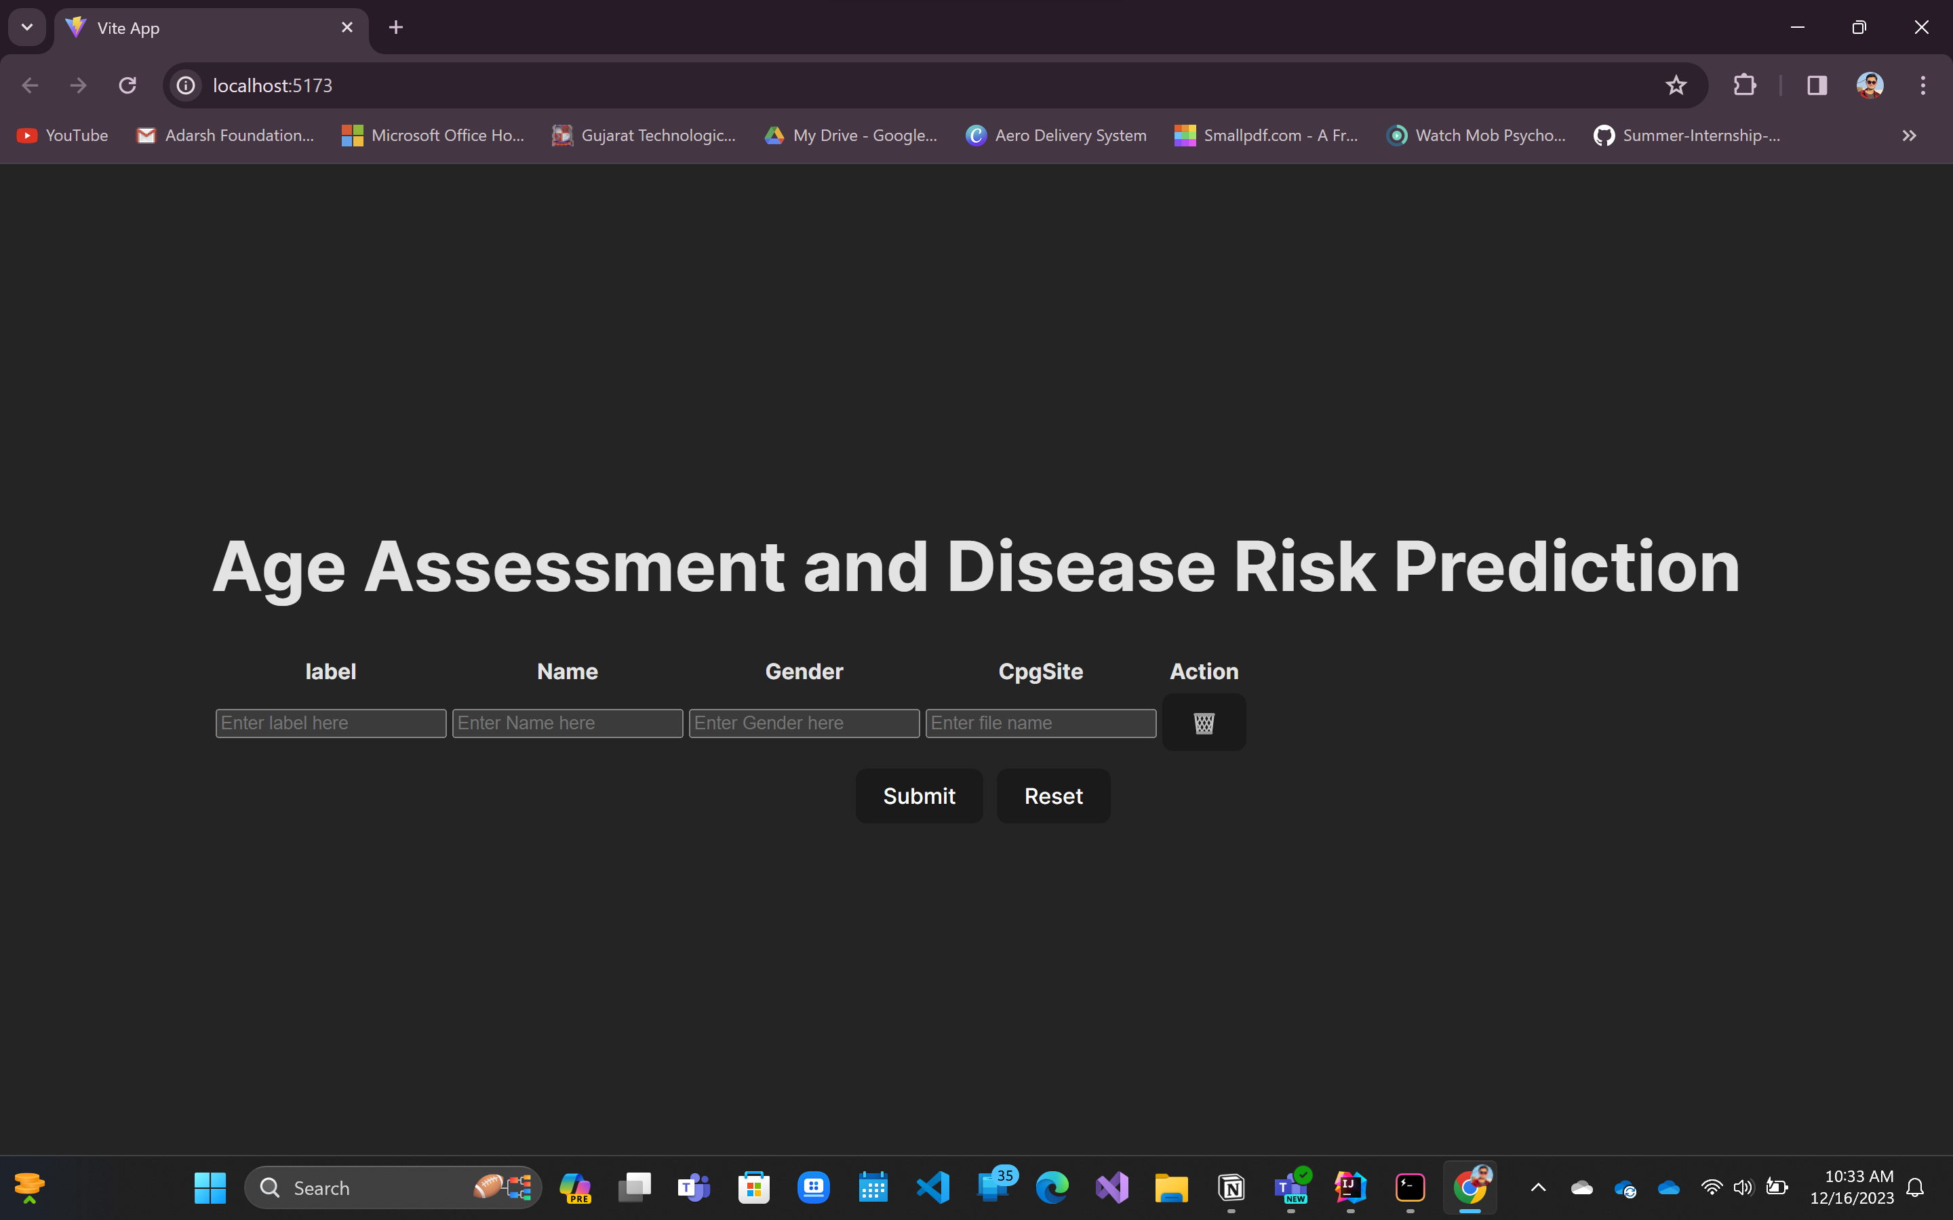
User Interface
CYSE7200 Big-Data Sys Engr Using Scala

Slide 11
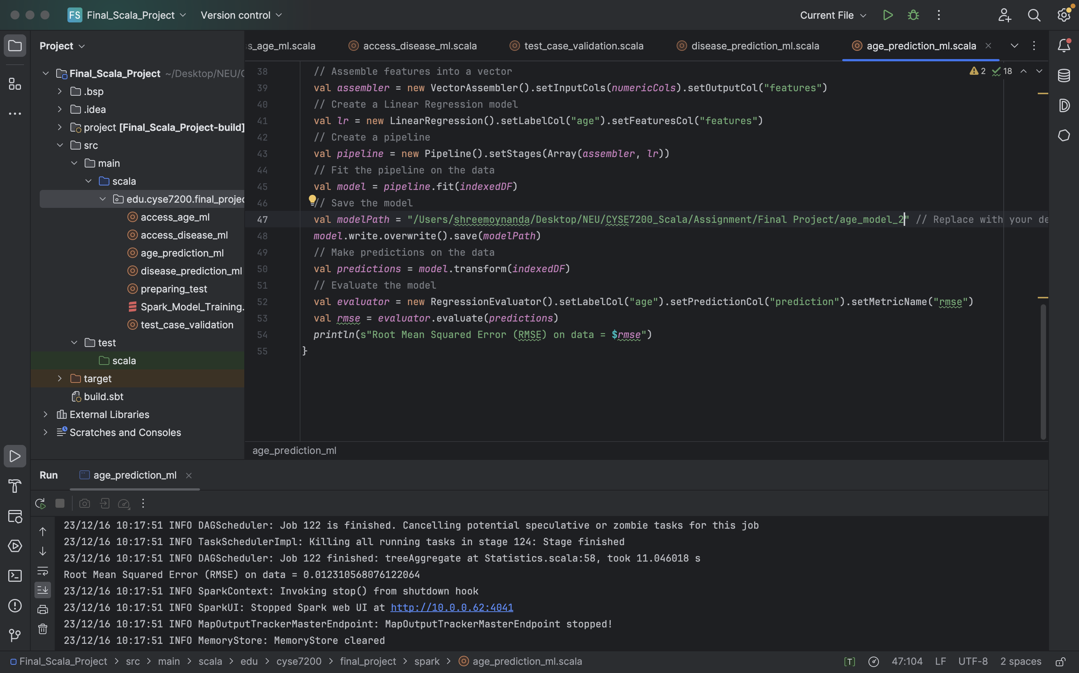
Age Prediction RMS
CYSE7200 Big-Data Sys Engr Using Scala

Slide 12
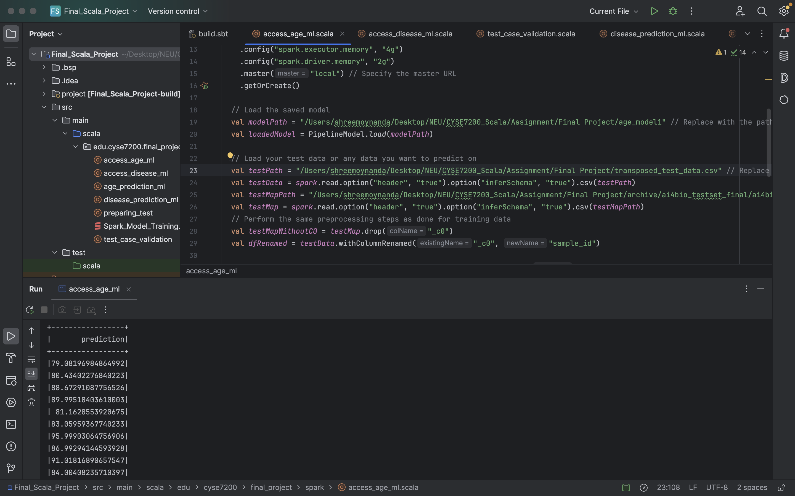
Age Prediction Output
CYSE7200 Big-Data Sys Engr Using Scala

Slide 13
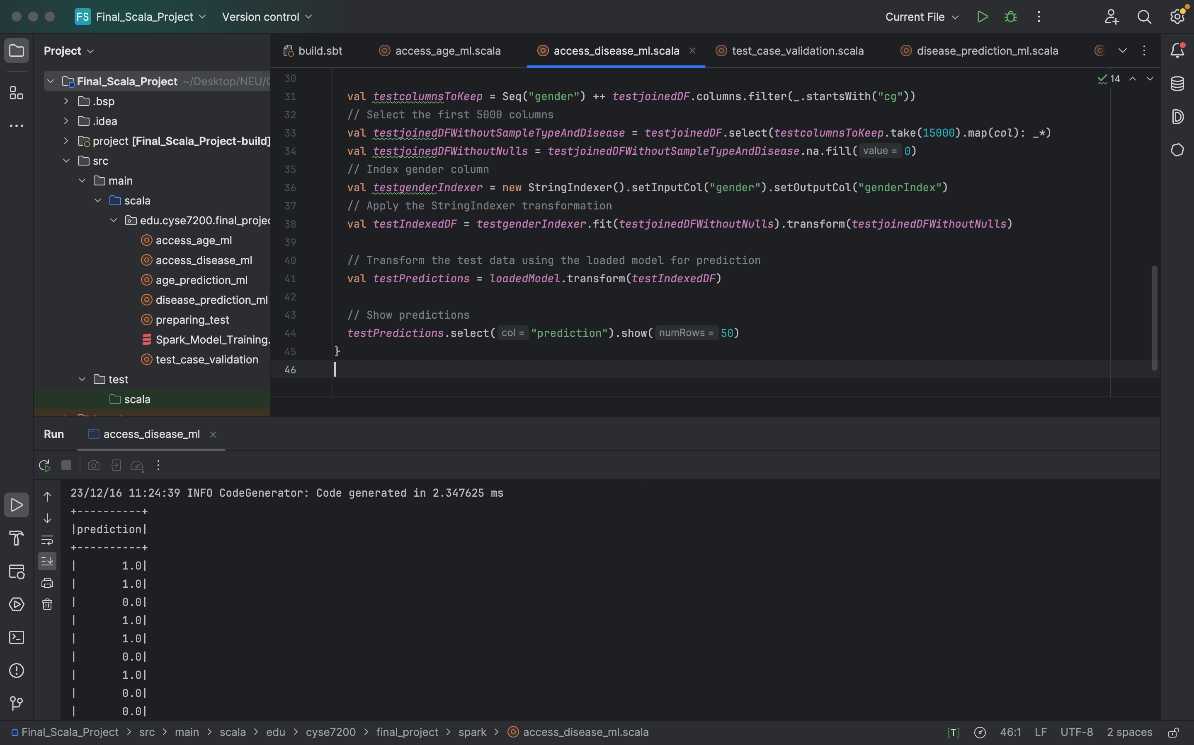
Disease Prediction Output
CYSE7200 Big-Data Sys Engr Using Scala

Slide 14
Acceptance Criteria
The RMS for age prediction should be within less than 2.
We have achieved an RMS of 0.01 for age.
The RMS for disease prediction should be within less than 2.2.
We have achieved an RMS of 0.02 for age
The Response time of the prediction less than 6 seconds.
We are getting the prediction in about 3.2 seconds. Even less depending on the number of inputs.
CYSE7200 Big-Data Sys Engr Using Scala

Slide 15
Infrastructure Issues
The actual training data file is of 60 GB.
Training Dataset contains 8233 training sample as columns and 485000+ cpgsites information as rows.
Spark-shell for an 8GB RAM system, it is recommended to have 2GB RAM at max dedicated to JVM, which is limits it to processing 20480 columns at max to be in a batch.
CYSE7200 Big-Data Sys Engr Using Scala

Slide 16
How we dealt with the problem
Due to the infrastructure limitation, we did the following things to make a dataset to handle the model.
We can take 1000 training sample from each disease with least null data associated to each.
We can take 400 healthy sample data, with similar concept on null handling
Finally coming to data, we will be taking 18000 rows of cpgsites with highest number of methylation data
CYSE7200 Big-Data Sys Engr Using Scala

